Slide 1
EETS 8332 Data Center Network Engineering
Dr. Scott Kingsley

Slide 2
Data Center Overlay Evolution

Slide 3
ETHERNET PROBLEMS
Flooding
ARP
Broadcast domains
MAC address table size
MAC address learning

Slide 4
Ethernet evolution to solve problems
1972 Ethernet begins
1982 Ethernet II
1982 IEEE 802.3
1998 802.1q
2006 Ethernet over MPLS
2007 VPLS
2008 802.3ih (PBB)
2011 TRILL (FABRICPATH)
2014 VXLAN
2015 EVPN
Legacy L2 technologies still rely on flooding and learning to build Layer 2 forwarding database

Slide 5
Problems with VXLAN and others
L2 and L3 both data plane only
VXLAN no control plane
Still used flooding
ARPs
MAC/IP address discovery

Slide 6
Ethernet Virtual Private Network (EVPN)
Ethernet VPN (EVPN) is a standards-based technology that provides virtual multipoint bridged connectivity between different Layer 2 domains over an IP backbone network.

Slide 7
Ethernet Virtual Private Network (EVPN) benefits
Integrated Services
Delivering Layer 2 and Layer 3 services over the same interface has been cumbersome until now.
Offering services with VPLS and L3VPNs requires multiple technologies and multiple customer service interfaces.
L3VPN-like operation with MP-BGP as the control plane protocol offers more scalability and control over learning and flooding.

Slide 8
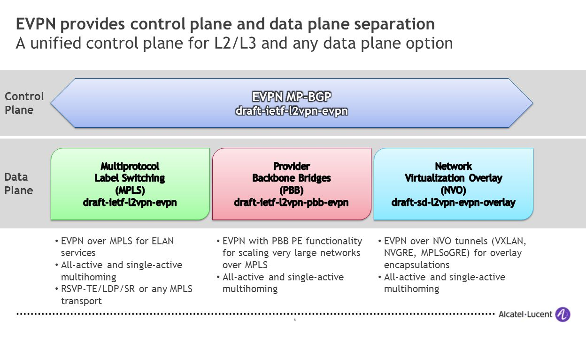
EVPN Control and Data Planes

Slide 9
BGP use in MPLS L3VPN
Multiprotocol Border Gateway Protocol (MP-BGP)
Device and IP address discovery
Virtual Routing Function (VRF)
Route Distinguisher (RD)
Route Target (RT)
Enables secure multitenancy

Slide 10
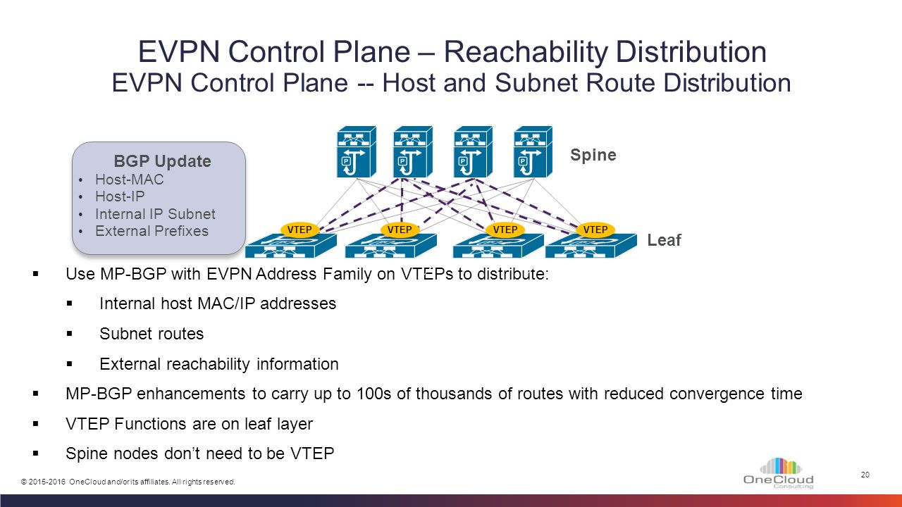
EVPN Operation

Slide 11
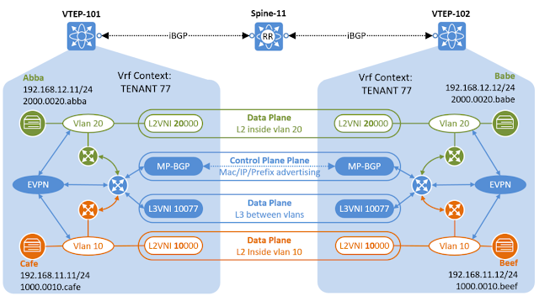
VXLAN MP-BGP EVPN SUMMARY

Slide 12
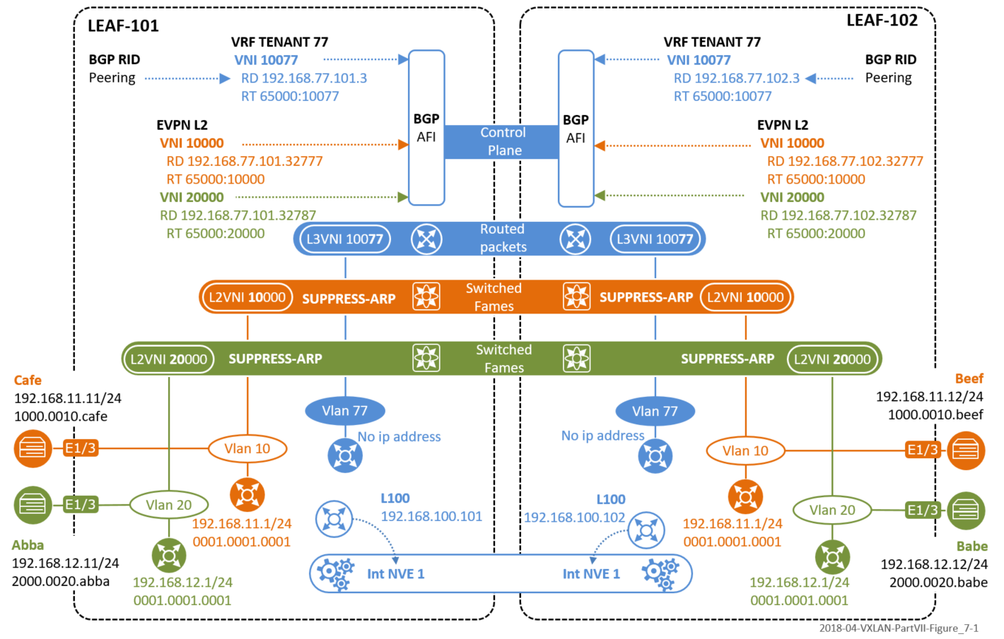
VXLAN MP-BGP EVPN SUMMARY

Slide 13
VXLAN MP-BGP EVPN ADVANTAGES
Standards-based Over lay (VXLAN) with standards-based control plane (BGP)
Layer 2 MAC and Layer 3 IP information distribution by control plane (BGP)
Forwarding decision based on scalable control plane (minimizes flooding)
Integrated Routing/Bridging (IRB) for Optimized Forwarding in the Overlay
Leverages Layer 3 ECMP – all links forwarding – in the underlay
Significantly larger name space in the over lay (16M segments)
Integration of physical and virtual net works with hybrid overlays
Facilitation of Software-Defined-Networking (SDN)

Slide 14
DISTRIBUTED ANYCAST GATEWAY
In order for two endpoints in different IP subnets to communicate with each other, a default gateway is required.
Distributed IP anycast gateway applies the anycast network concept “one to the nearest association.”
Anycast is a network addressing and routing methodology in which the data traffic from an endpoint is routed topologically to the closest node in a group of gateways that are all identified by the same destination IP address.

Slide 15
DISTRIBUTED ANYCAST GATEWAY
The Distributed Anycast gateway feature in EVPN, enables an end host in a VNI to always use its local VTEP as the default gateway, to send traffic outside its subnet. In host mobility scenarios, because the gateway IP and MAC address are identical on all VTEPs for a VNI, if the host moves behind a different VTEP, its gateway address still remains the same. Thus, with Anycast Gateways, all VTEPs:
For a particular VNI, have identical Gateway Virtual IP Addresses
Across All VNIs, have identical Gateway Virtual MAC addresses.

Slide 16
YOUTUBE
Distributed anycast
https://www.youtube.com/watch?v=xr1u3LUwcek
NANOG
https://www.youtube.com/watch?v=p8RJU3LMQG8
Huawei
https://www.youtube.com/watch?v=mhzHj3yd6ek

Slide 17
EVPN Control and Data Planes

Slide 18
Huawei description of VXLAN BGP EVPN
https://support.huawei.com/enterprise/en/doc/EDOC1100168670#EN-US_TOPIC_0291591611

Slide 19
Topics to follow:
Why EVPN?
BGP + EVPN
EVPN Route Types
MAC address learning with EVPN
Intra-subnet VXLAN tunnel establishment
Inter-subnet VXLAN Tunnel Establishment and Route Advertisement
Intra-subnet packet forwarding
Inter-subnet packet forwarding

Slide 20
Why was EVPN developed?
In the initial VXLAN solution (RFC 7348), no control plane is defined.
VXLAN tunnels are manually configured, and host addresses are learned through traffic flooding.
This method is easy to implement, but it causes a lot of flooding traffic on the network and makes network expansion difficult.
To solve the preceding problems, EVPN is introduced as the control plane of VXLAN that is a network virtualization overlay (NVO) protocol.

Slide 21
BGP
Traditional BGP-4 peers use Update messages to exchange routing information.
An Update message can advertise reachable routes with the same path attribute.
These routes are carried in the Network Layer Reachability Information (NLRI) field.
BGP-4 can manage only IPv4 unicast routing information, so MP-BGP was developed to support multiple network layer protocols, such as IPv6 and multicast.
MP-BGP extends NLRI based on BGP-4. After extension, the description of the address family is added to NLRI to differentiate network layer protocols, such as the IPv6 unicast address family and VPN instance address family.

Slide 22
BGP + EVPN
Using EVPN as the control plane of VXLAN has the following advantages:
VTEPs can be automatically discovered and VXLAN tunnels can be automatically established, simplifying network deployment and expansion.
EVPN can advertise both Layer 2 MAC address information and Layer 3 routing information.
Flooding traffic is reduced on the network.

Slide 23
BGP + EVPN
Similarly, EVPN uses the MP-BGP mechanism and defines a new sub-address family, EVPN address family, in the L2VPN address family.
In the EVPN address family, a new type of NLRI is added, that is, EVPN NLRI.
EVPN NLRI defines several types of BGP EVPN route types, which can carry information such as the host IP address, MAC address, VNI, and VRF. After a VTEP learns the IP address and MAC address of a connected host, the VTEP can send the information to other VTEPs through MP-BGP routes.
In this way, learning of host IP address and MAC address information can be implemented on the control plane, suppressing traffic flooding on the data plane.

Slide 24
EVPN changes the paradigm: MAC addresses are also advertised in MP-BGP
CE attaches to MAC-VRF In VTEP.
VXLAN VTEP discovers IP/MAC addresses from CE.
EVPN/BGP discovers VTEPs.
EVPN/BGP discover and authenticates VXLAN tunnel endpoints (VTEP) dynamically.
EVPN NLRI binds MAC and IP addresses.
EVPN NRLI into BGP Extended Communities (L2VPN).
VTEP establish L3 VNI connections and related L2 VNI.
Terminate Address Resolution Protocol (ARP) requests early and minimize flooding

Slide 25
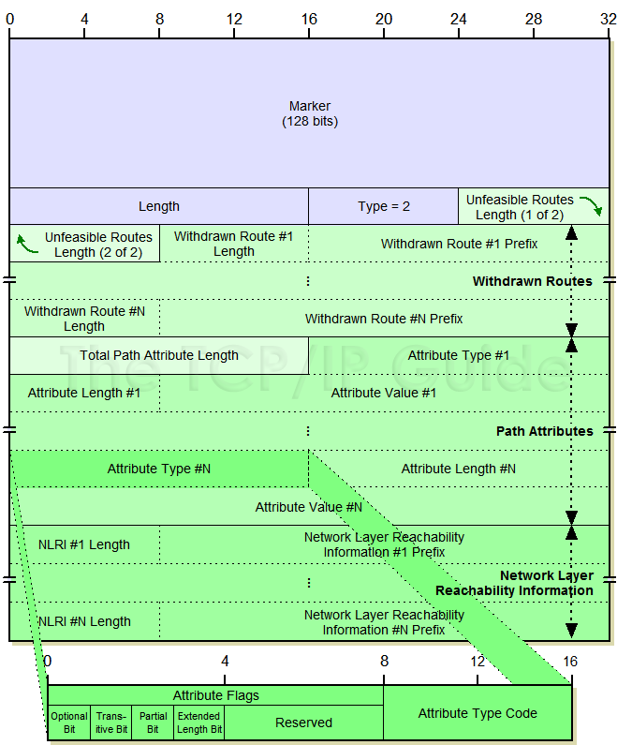
EVPN NLRI Messages Carried in BGP Update as Attribute Code 16
BGP Extended Communities Attribute
The Extended Communities Attribute is a transitive optional BGP attribute, with the Type Code 16.
EVPN NRLI into BGP Extended Communities (L2VPN).
EVPN NLRI binds MAC and IP addresses.
EVPN routes types 1-5

Slide 26
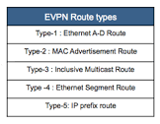
EVPN Route Types
Type 1 and Type 4 routes are used in EVPN Ethernet Segment Identifier (ESI) all-active scenarios. The EVPN ESI all-active function allows multi-homing and all-active VXLAN gateways to be deployed based on RFC standards, effectively improving the reliability on the VXLAN access side.
Type 5 advertises network segments.
Concerned mostly with Type 2 and 3 routes

Slide 27
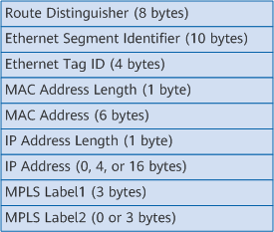
EVPN Type 2 Route: VTEPs advertise MAC/IP
EVPN Type 2 routes, also called MAC/IP advertisement routes, are used by VTEPs to advertise host IP and MAC address information to each other.
L2VNI carried in the route. This field is used to identify a BD.
L2VNI

Slide 28
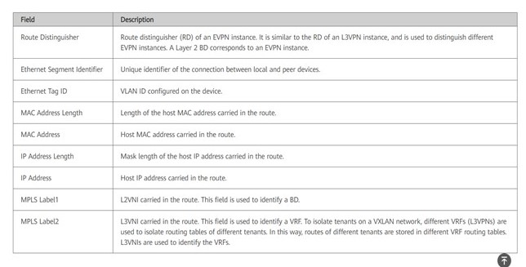
EVPN Type 2 Route: VTEPs advertise MAC/IP

Slide 29
EVPN Type 2 Route: VTEPs advertise MAC/IP
Layer 2 Connection: Same subnet
Same subnet, the VTEPs at both ends must learn host MAC addresses from each other (more detail on this soon.).
To achieve this, after a BGP EVPN peer relationship is established between the VTEPs, they exchange Type 2 routes in order to advertise host MAC addresses to each other.

Slide 30
EVPN Type 2 Route: VTEPs advertise MAC/IP
Layer 3 Connection: Different subnets
To implement Layer 3 communication between hosts on different subnets in a distributed gateway scenario, the VTEPs (functioning as Layer 3 gateways) at both ends must learn host IP routes from each other.
To achieve this, after a BGP EVPN peer relationship is established between the VTEPs, they exchange Type 2 routes in order to advertise host IP routes to each other.

Slide 31
EVPN Type 3 Route: Advertise L2VNI and VTEP IP Address
EVPN Type 3 routes are used by VTEPs to advertise L2VNIs and VTEP IP addresses to each other for creating an ingress replication list (routing tree).
That is, Type 3 routes are used for automatic VTEP discovery and dynamic VXLAN tunnel establishment.
If there is a reachable route to the peer VTEP's IP address, a VXLAN tunnel is established from the local VTEP to the peer VTEP.
Additionally, if the local and remote VNIs are the same, an ingress replication list is created for BUM packet forwarding.

Slide 32
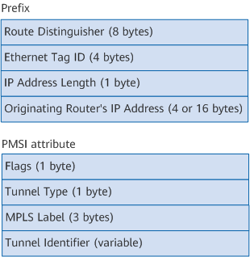
EVPN Type 3 Route: Advertise L2VNI and VTEP IP Address
The NLRI of Type 3 routes consists of a prefix and a PMSI (P-Multicast Service Interface) attribute.
The Originating Router's IP Address field of the NLRI contains VTEP IP address information, and
the MPLS Label field of the PMSI attribute contains L2VNI information.

Slide 33
EVPN Type 3 Route: Advertise L2VNI and VTEP IP Address
Field | Description
Route Distinguisher | RD of an EVPN instance.
Ethernet Tag ID | VLAN ID configured on the device. The value is all 0s in a Type 3 route.
IP Address Length | Mask length of the local VTEP's IP address carried in the route.
Originating Router's IP Address | Local VTEP's IP address carried in the route.
Flags | Flags indicating whether leaf node information is required for the tunnel. In a VXLAN scenario, this field is meaningless.
Tunnel Type | Tunnel type carried in the route. In a VXLAN scenario, the value must be 6: Ingress Replication currently, which is used for BUM packet forwarding.
MPLS Label | L2VNI carried in the route.
Tunnel Identifier | Tunnel information carried in the route. In a VXLAN scenario, this field also indicates the local VTEP's IP address currently

